Slide 1
Jane Street Competition

Slide 2
Data
10 partitions
In the following, I selected partition id = 9
Symbol = 1

Slide 3
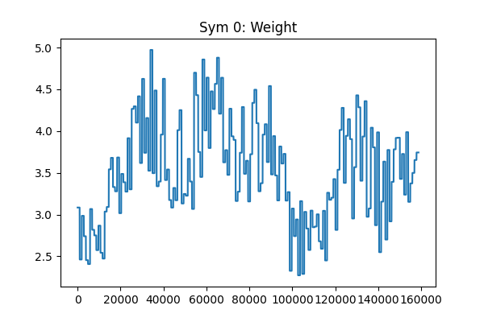
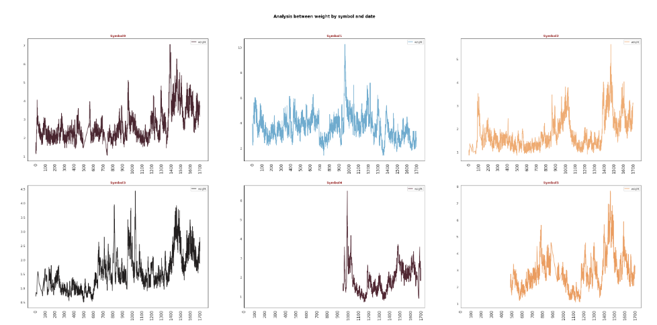
Weights
https://www.kaggle.com/code/ravi20076/janestreet2024-eda-v1

Slide 4
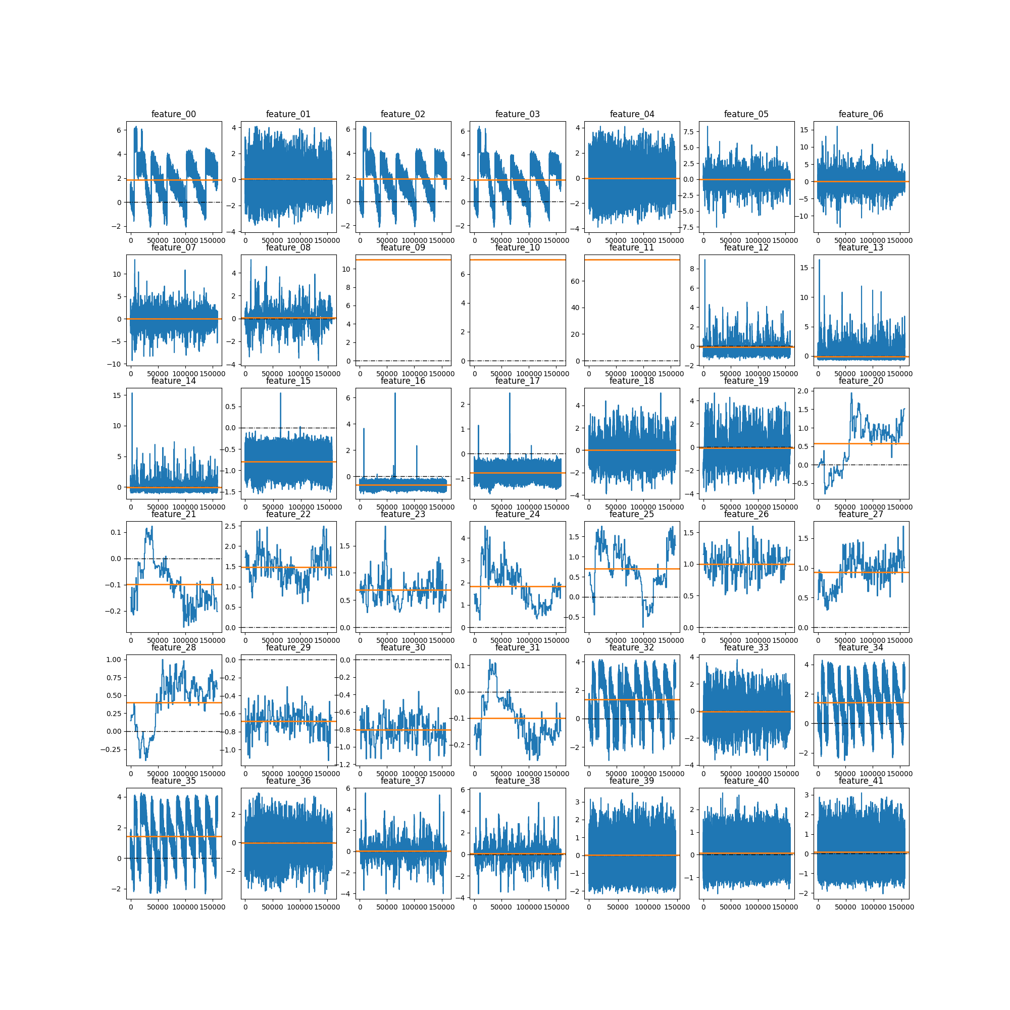
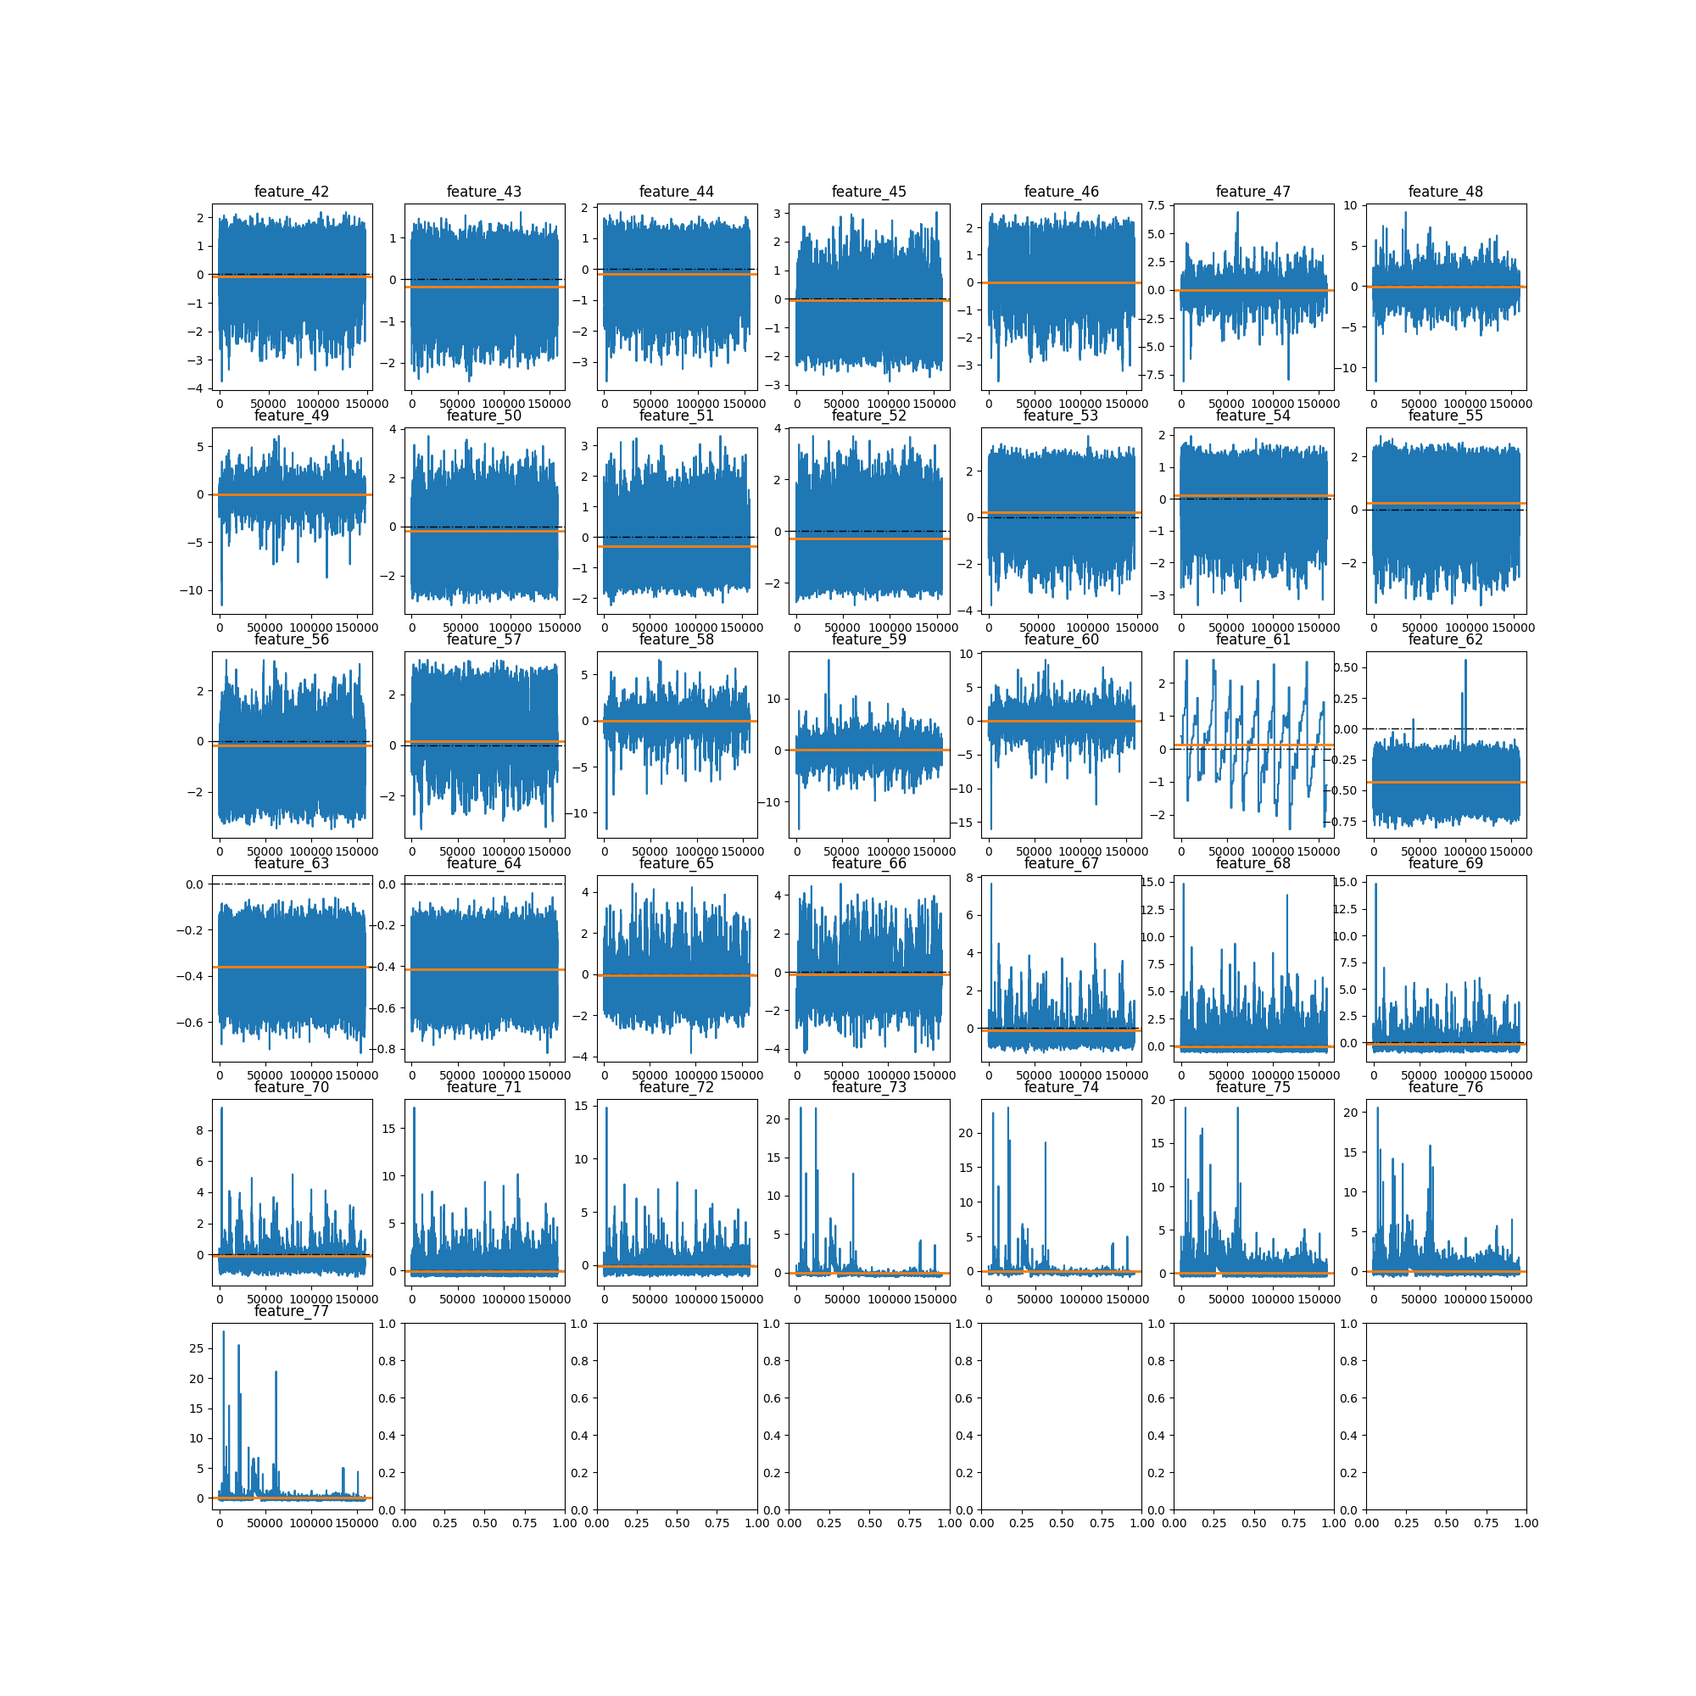
Features

Slide 5
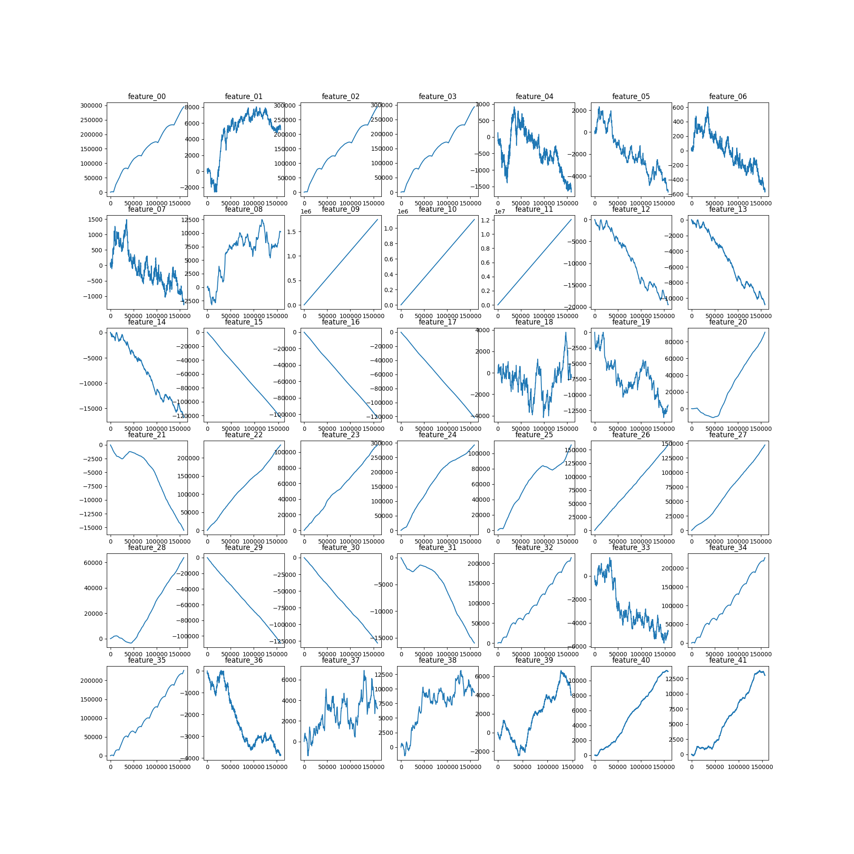
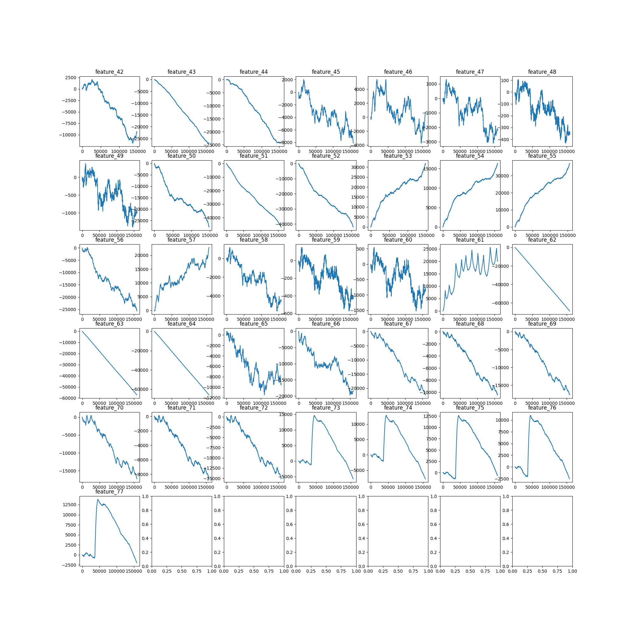
Features - Cumulative

Slide 6
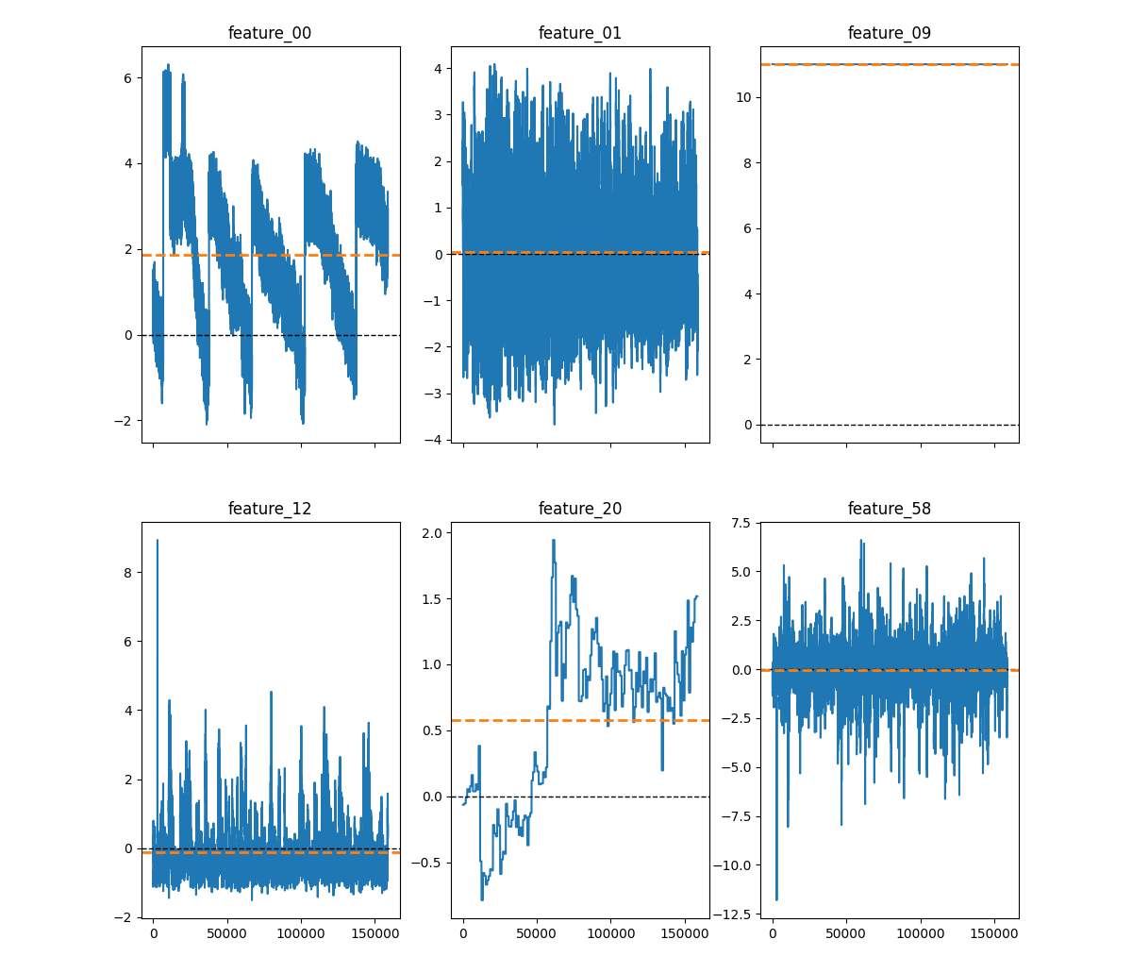
Features – Distributions
Very different from each other
Feature_09 is categorical
Features are not centralized per symbol

Slide 7
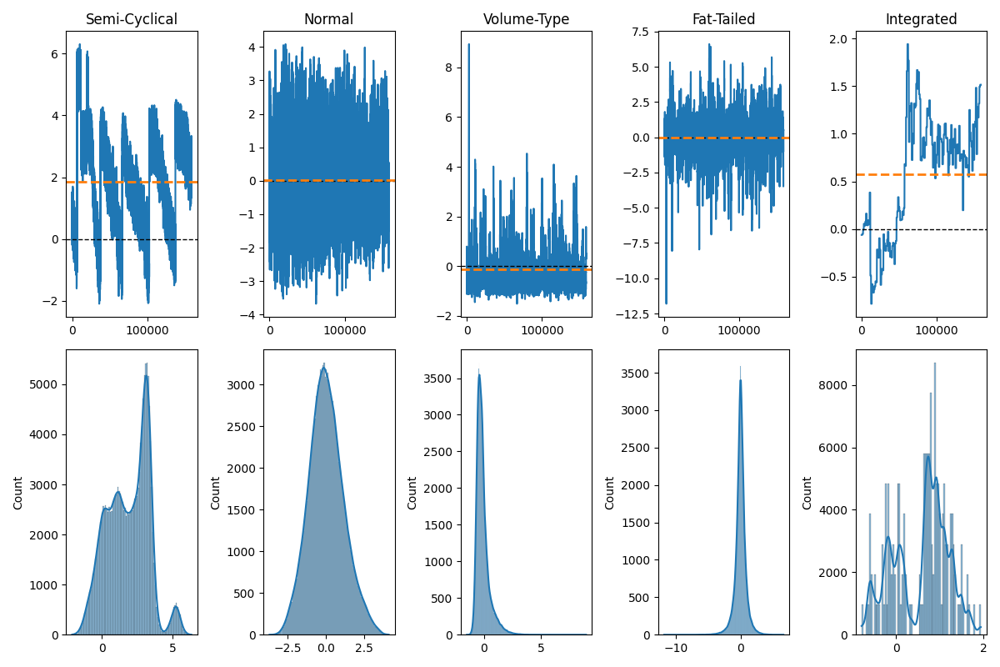
Features – Distributions
Likely, if we process the features appropriately, models will improve

Slide 8
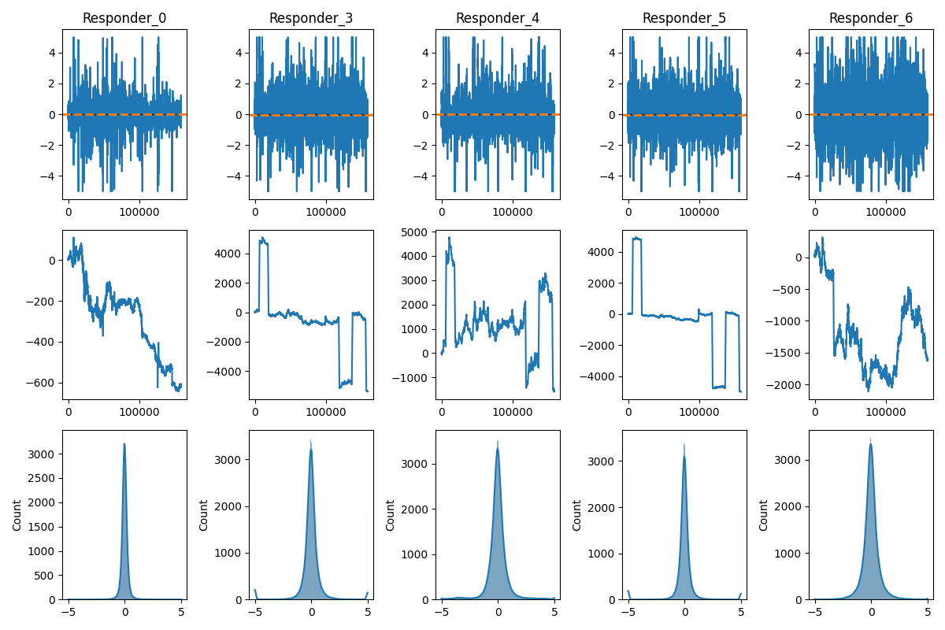
Responders (a Subset)
Nasty jump

Slide 9
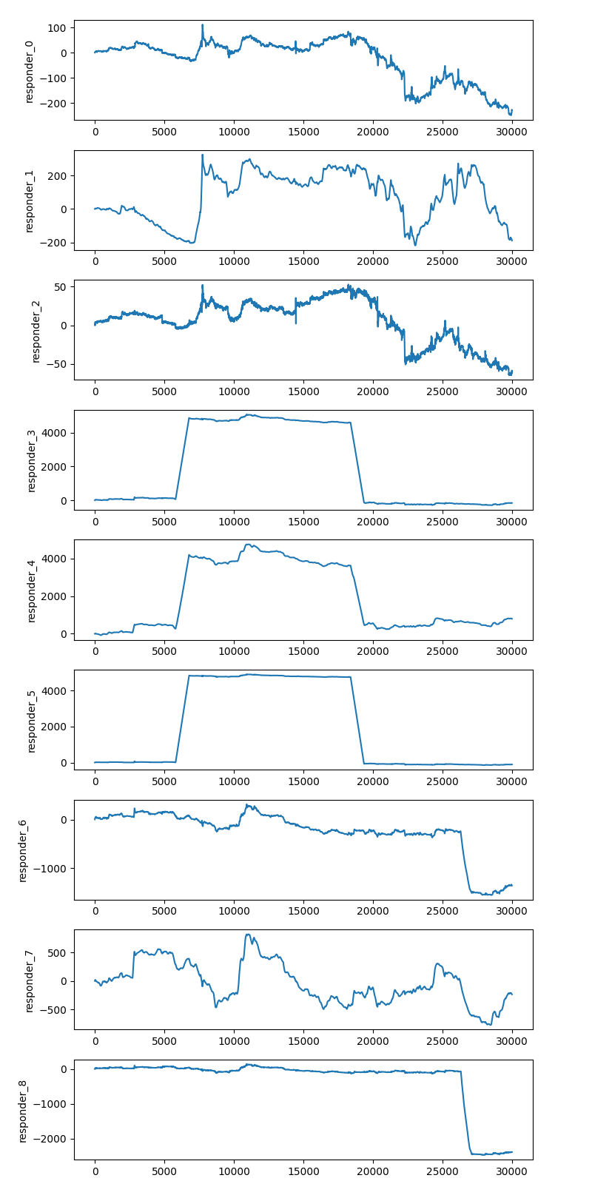
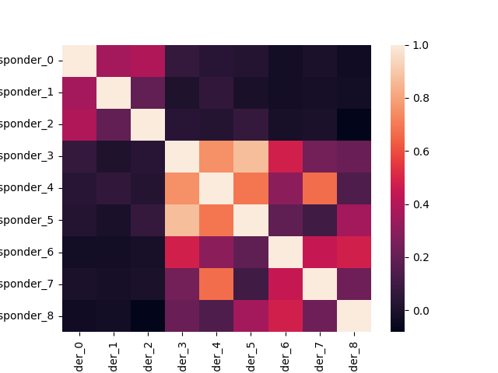
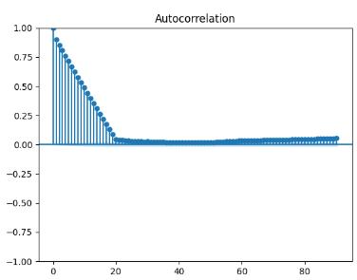
Responder 6 Jump
I guess, 3 groups of 3 responders
Jumps occur over a period of time: short but not instantaneous
Very strong autocorrelation, thus lag is a must since it’s likely the single best predictor
This is in levels: not meaningful
See analysis on slides 25-26

Slide 10
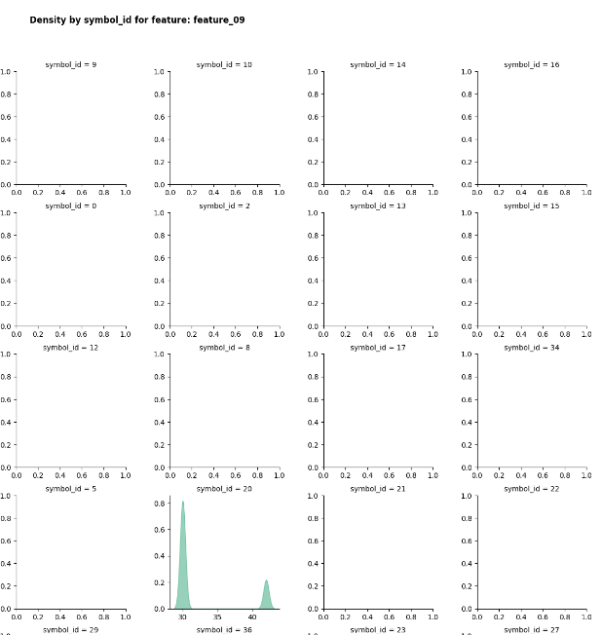
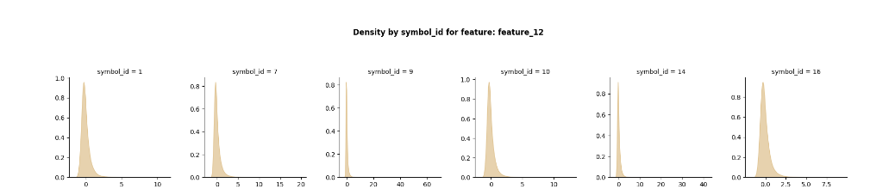
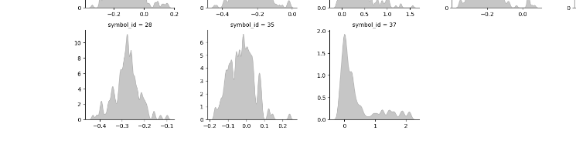
EDA - Crowd
https://www.kaggle.com/code/michau96/jane-street-features-by-financial-instruments

Slide 11
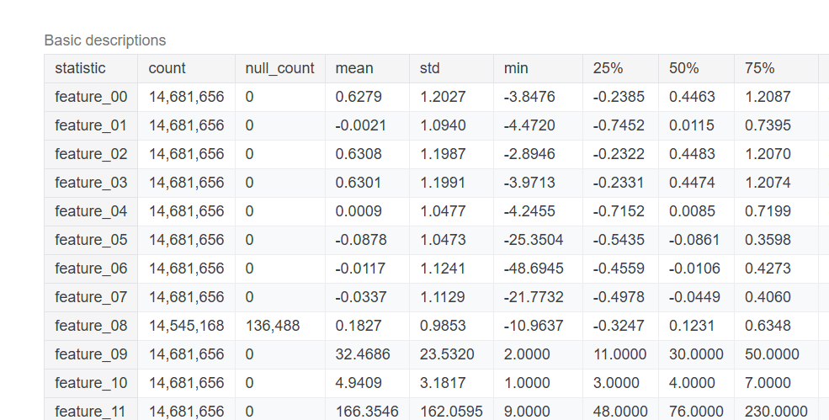
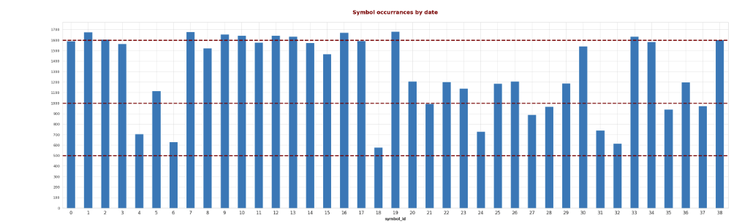
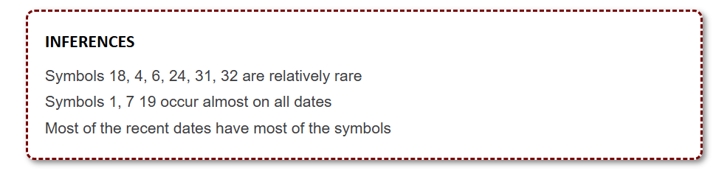
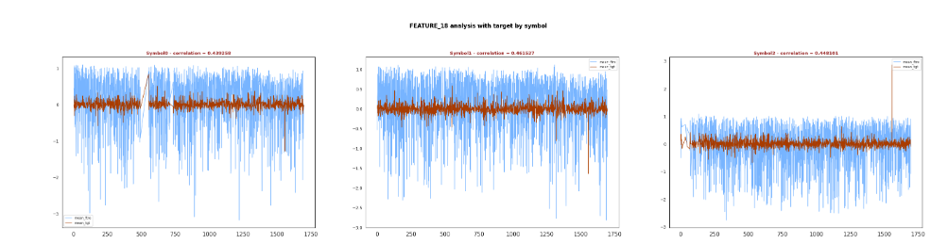
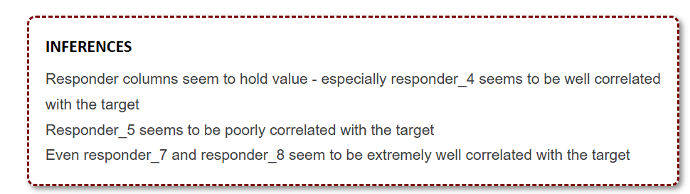
Stats
https://www.kaggle.com/code/ravi20076/janestreet2024-eda-v1

Slide 12
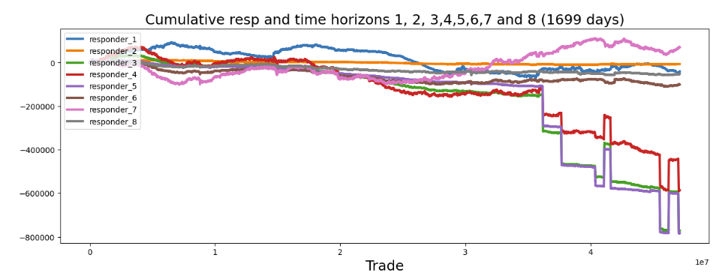
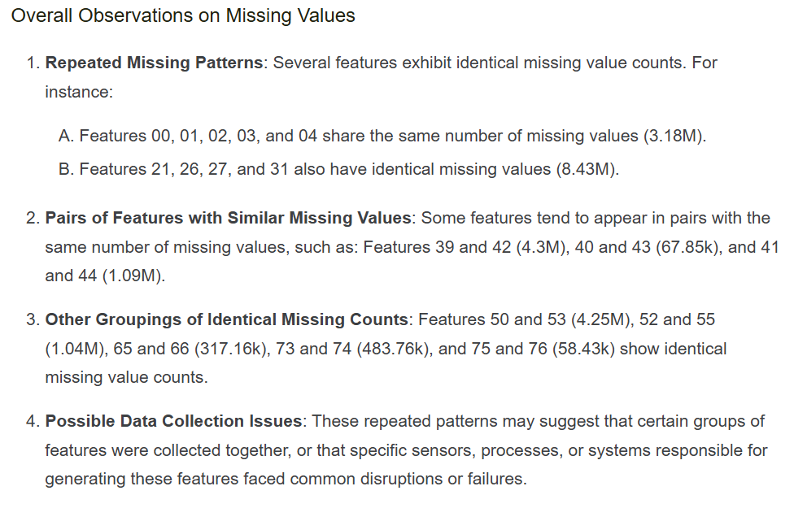
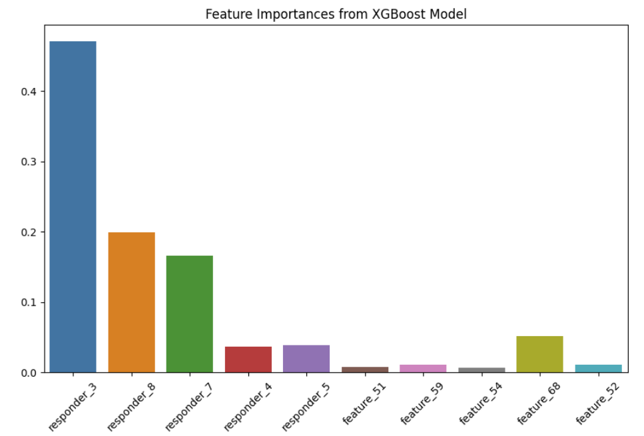
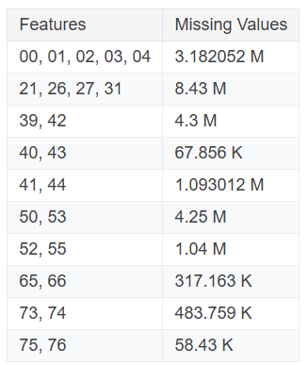
Feature Importance
https://www.kaggle.com/code/ahsuna123/jane-street-24-day-0-eda-and-feature-importance

Slide 13
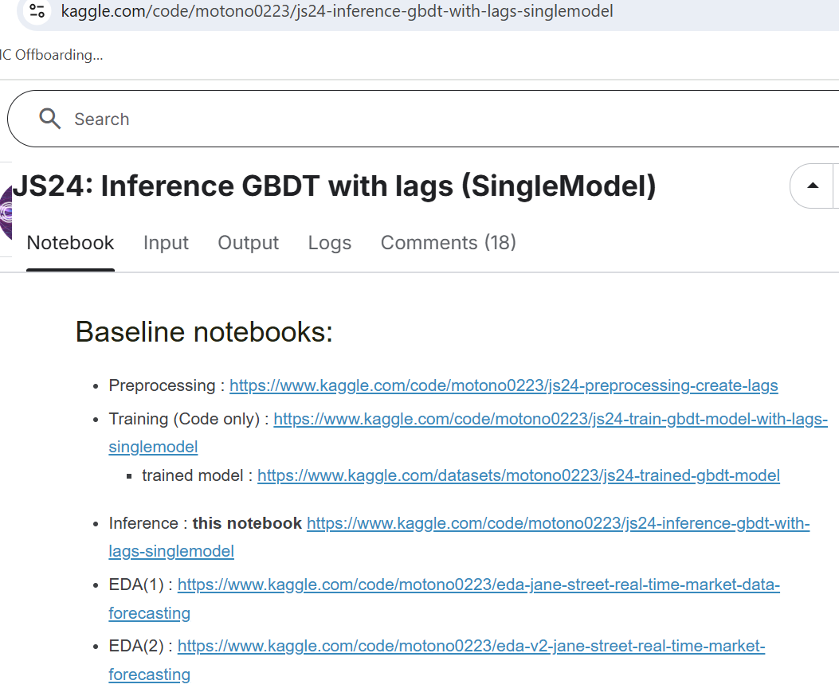
Some More Comprehensive Work

Slide 14
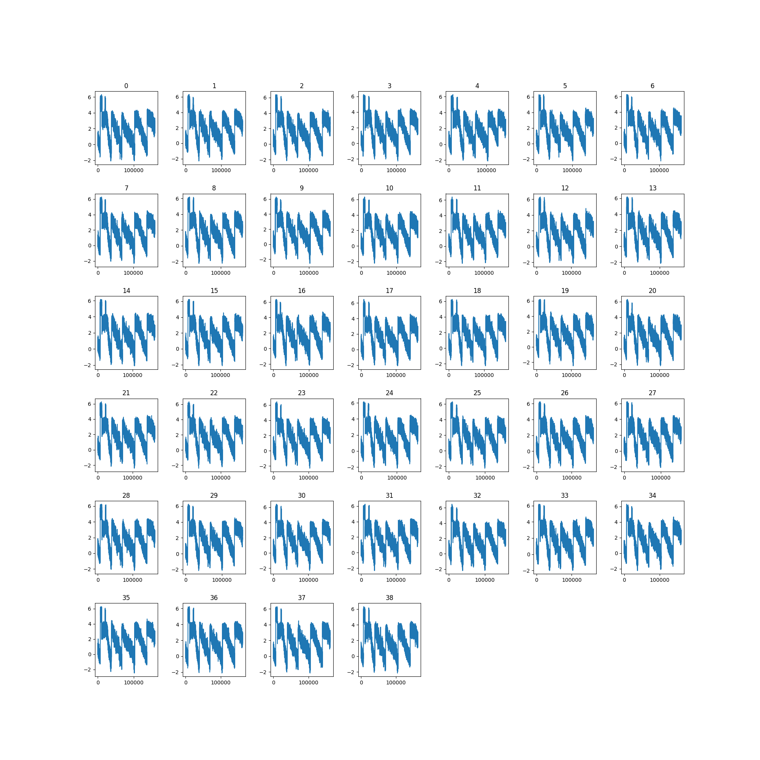
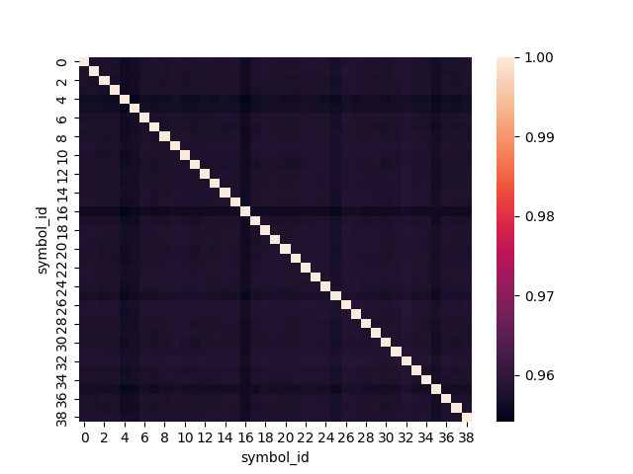
Feature 00 Across Symbols
At least visually, the ‘transitions’ seem to happen at the same time
The correlation between symbols is extremely high
Either it reflects a ‘fundamental’ signal
Or we need to pre-process it to extract the relevant piece for each symbol

Slide 15
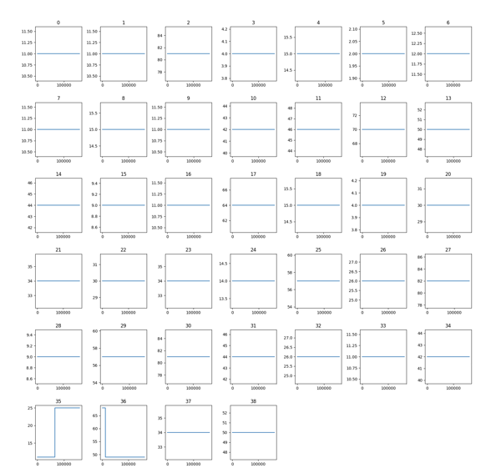
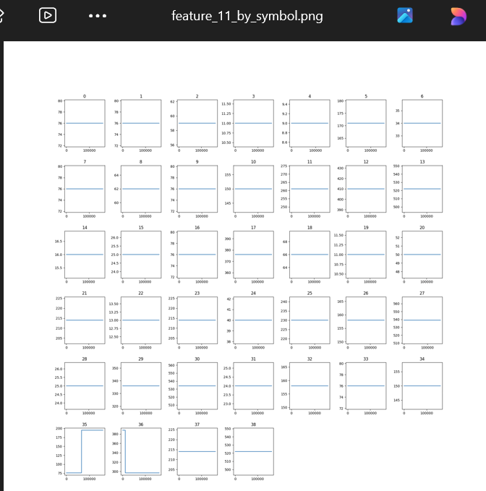
Feature 09 and 11 by Symbol
Category for a given symbol can change over time
Maybe transitions happen at the same time
This could reflect a change in methodology

Slide 16
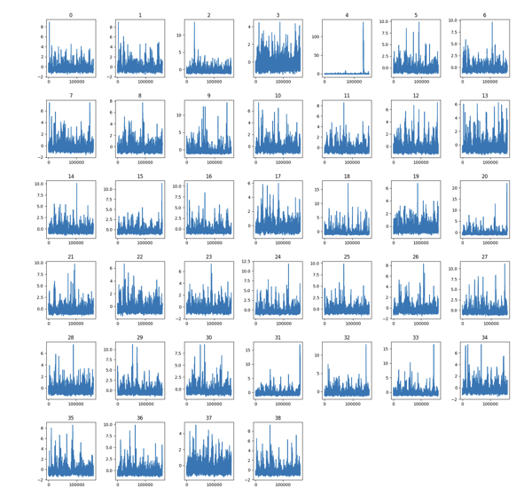
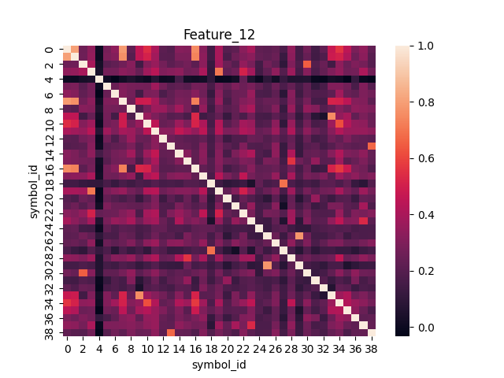
Feature 12 by Symbol
Volume-like
Quite different across symbols
Similar for 13-19

Slide 17
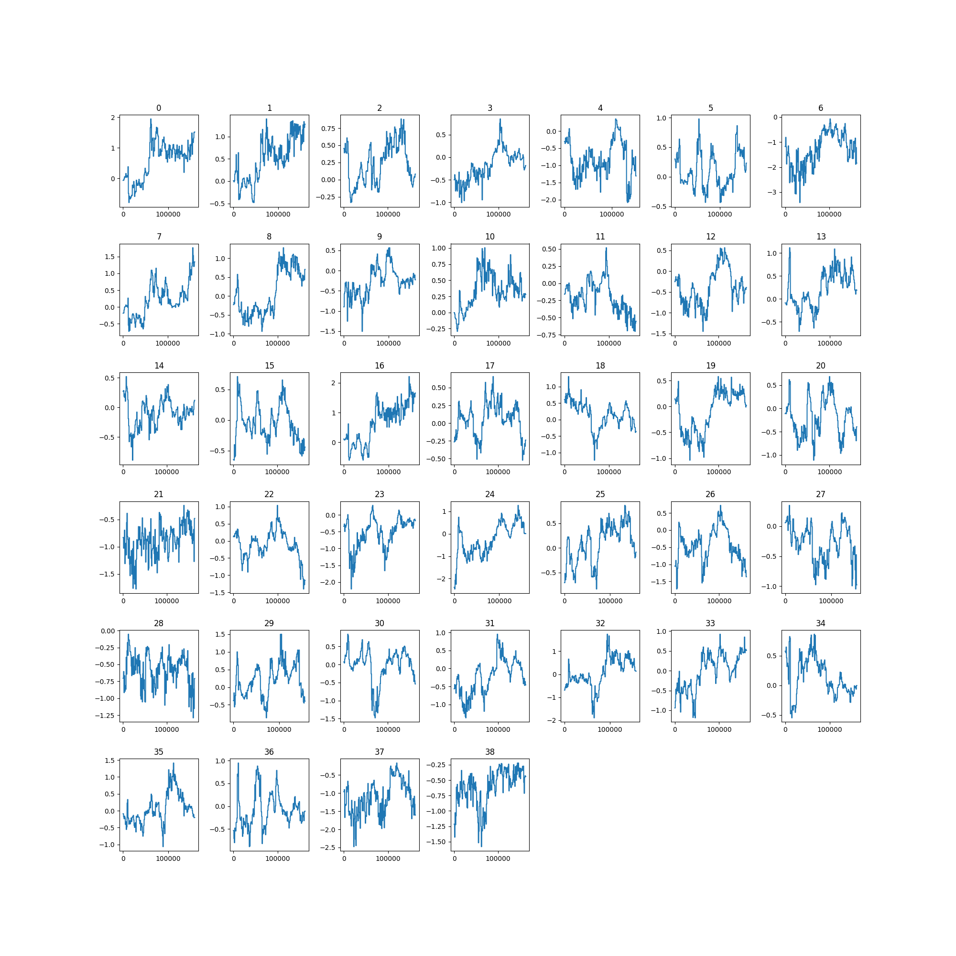
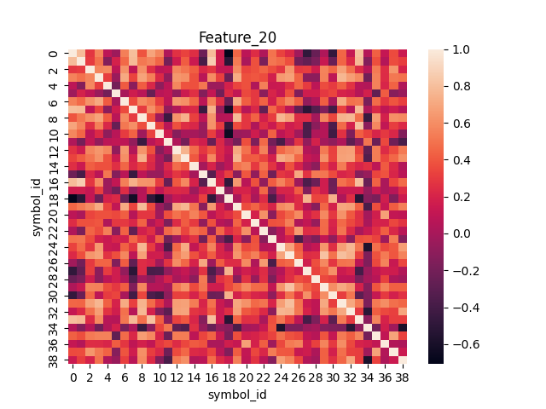
Feature 20
Integrated
Very different
Chances are we should take differences

Slide 18
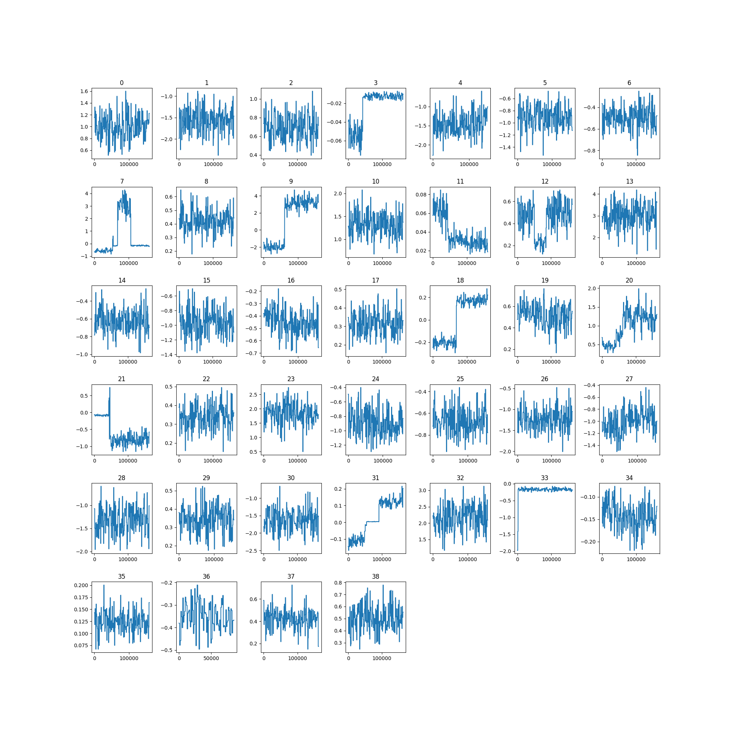
Feature 26
Even more different
Bizarre …
VERY time-varying

Slide 19
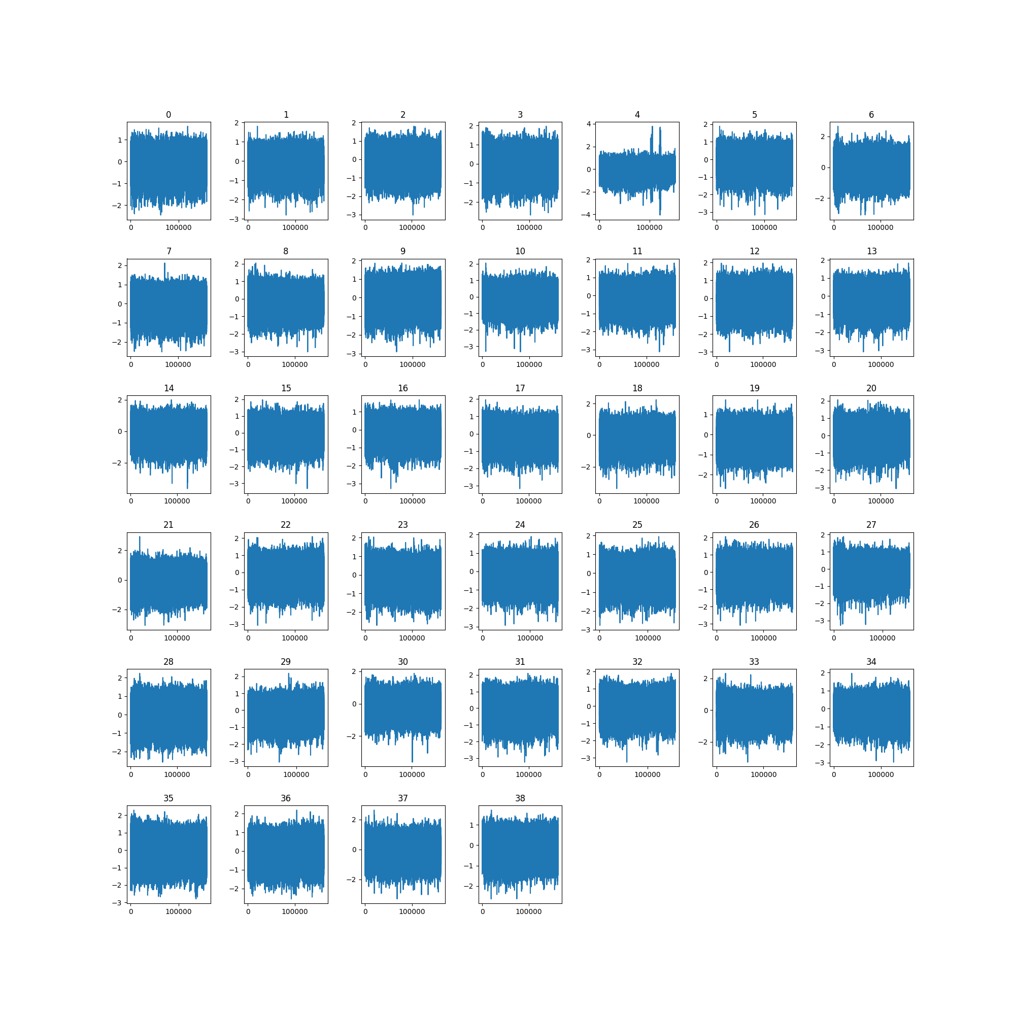
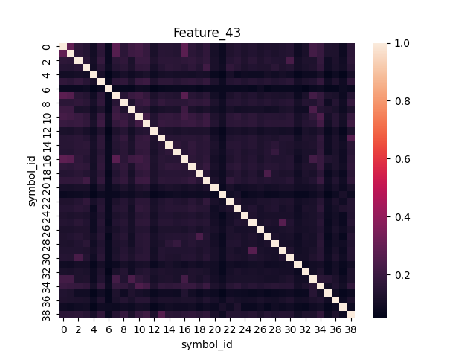
Feature 43
Almost uncorrelated

Slide 20
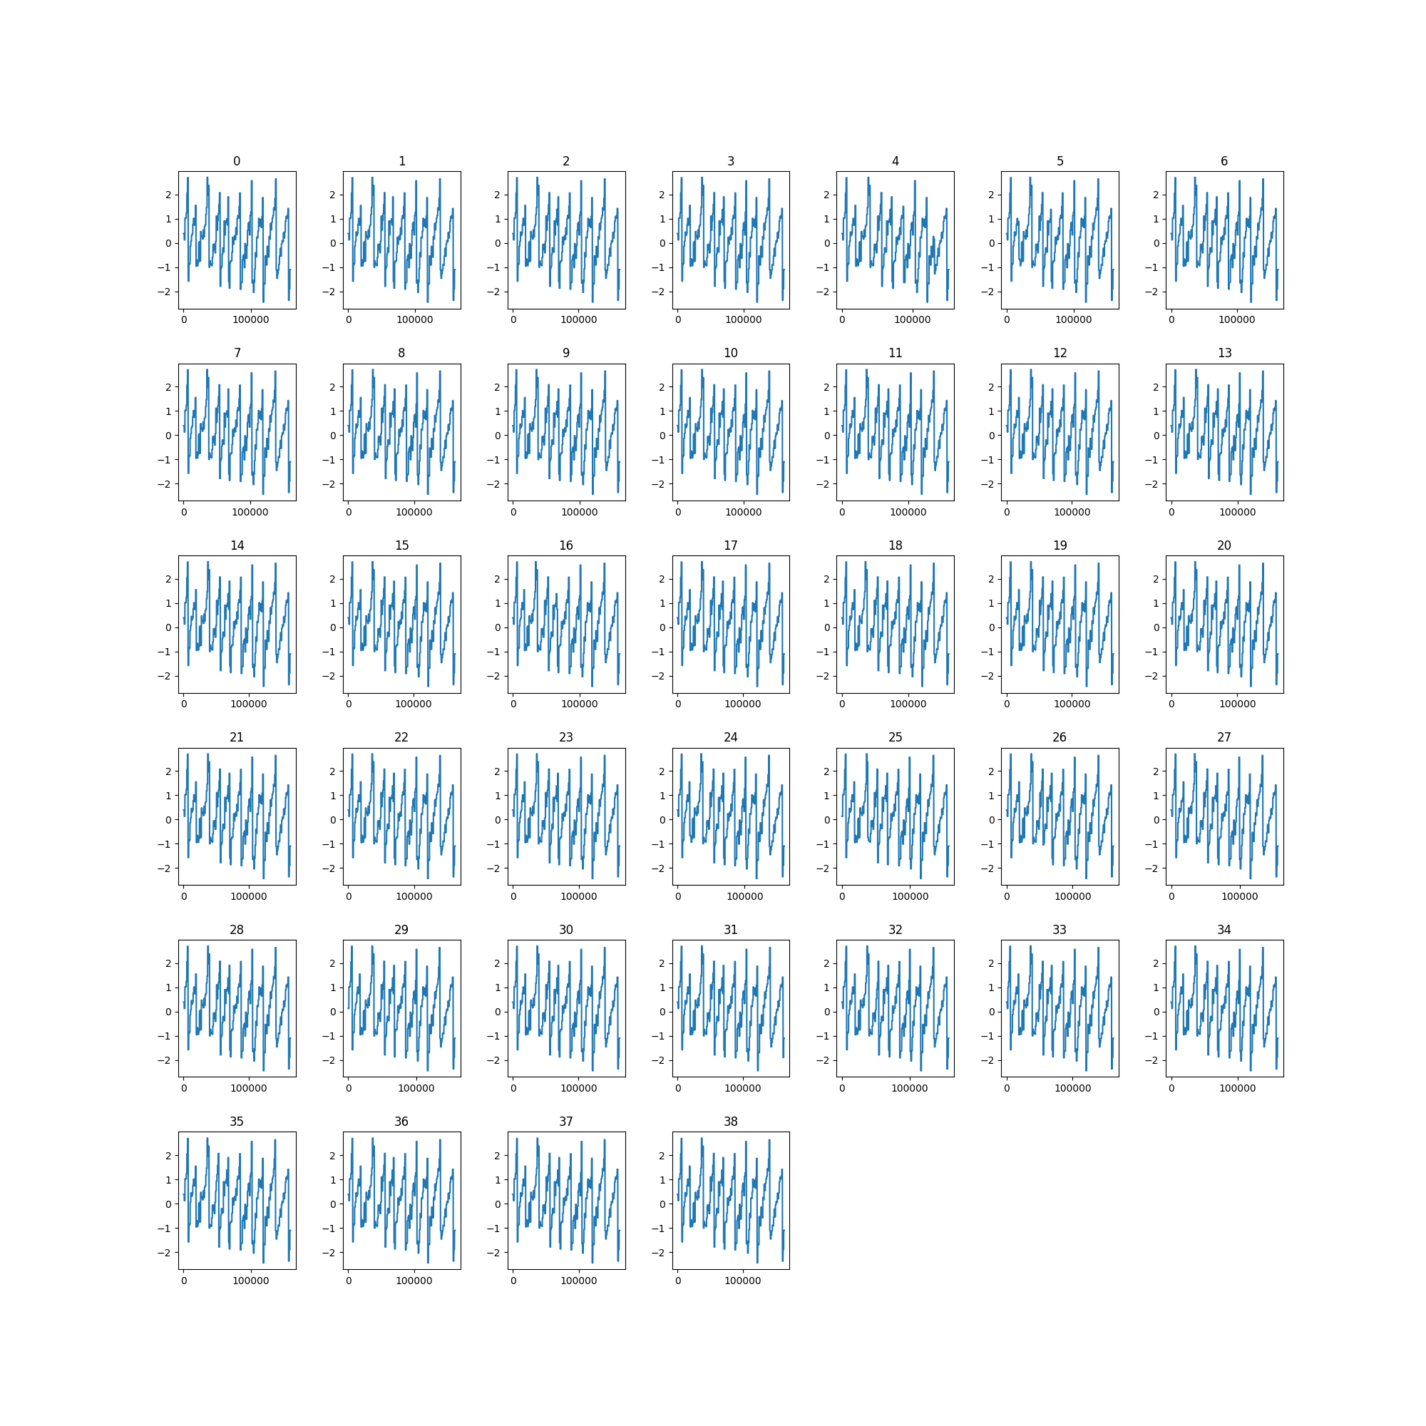
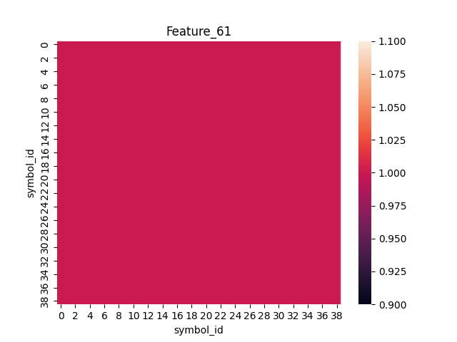
Feature 61
Same for each symbol?

Slide 21
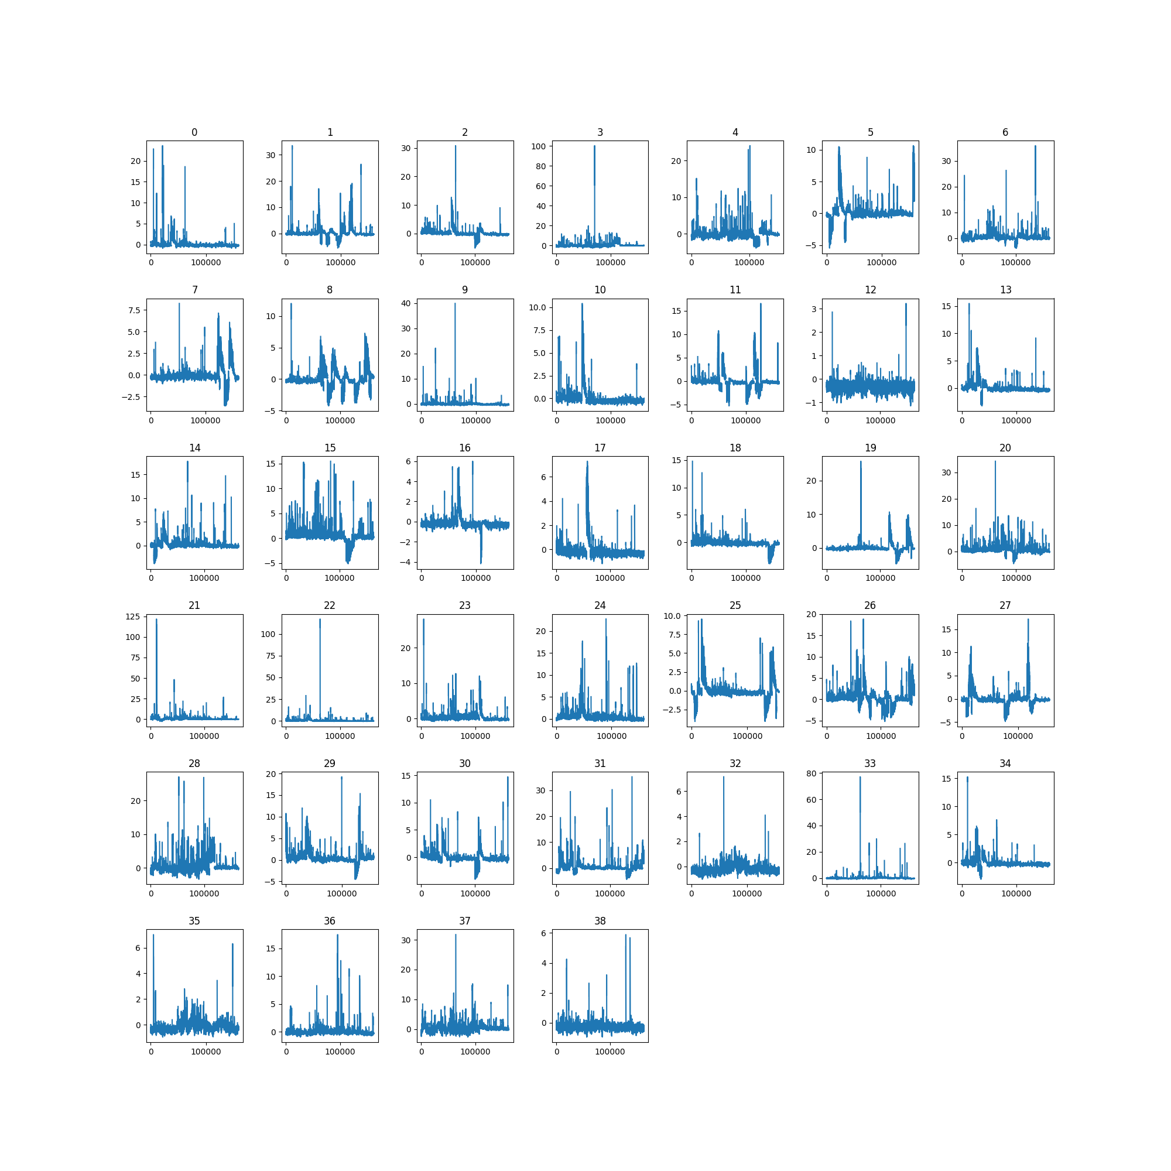
Feature 74
Ugly …

Slide 22
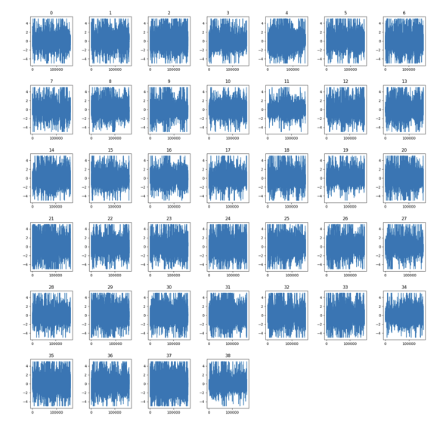
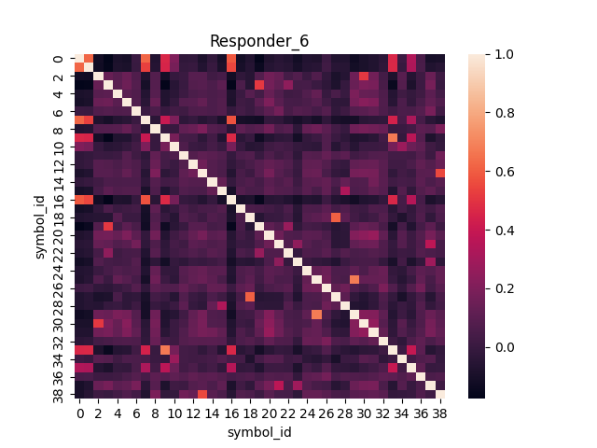
Responder 6

Slide 23
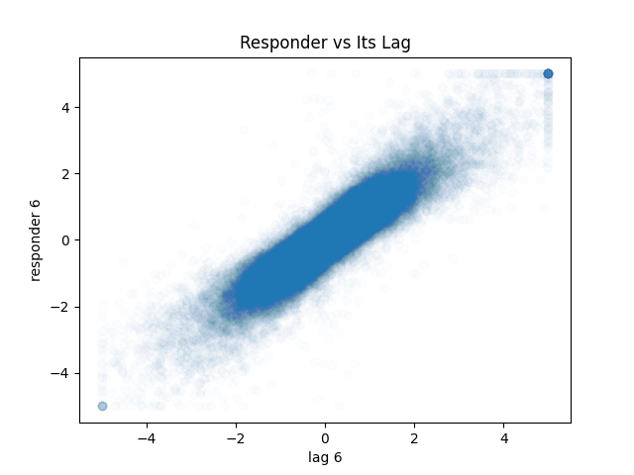
Lagged Responder 6
Correlation = 0.90

Slide 24
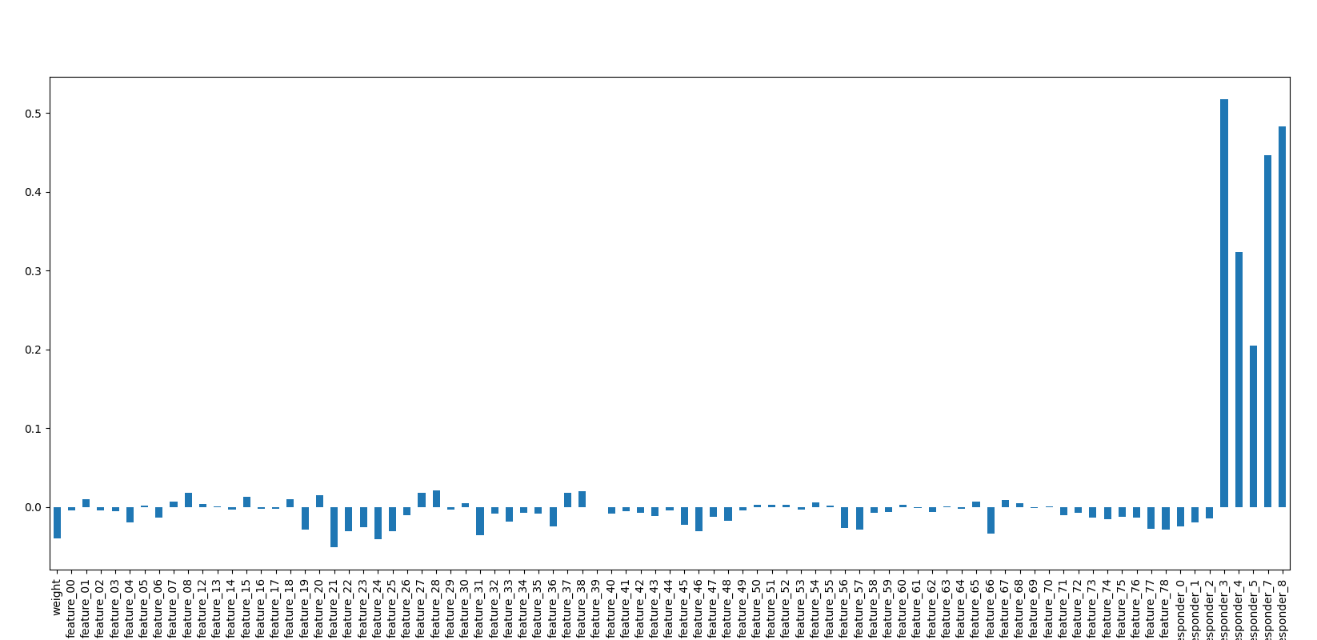
Correlations to Responder 6
Correlations are massively smaller
Except for some other responders
I will look into lagged versions
Although we need to check if we have access to contemporaneous values

Slide 25
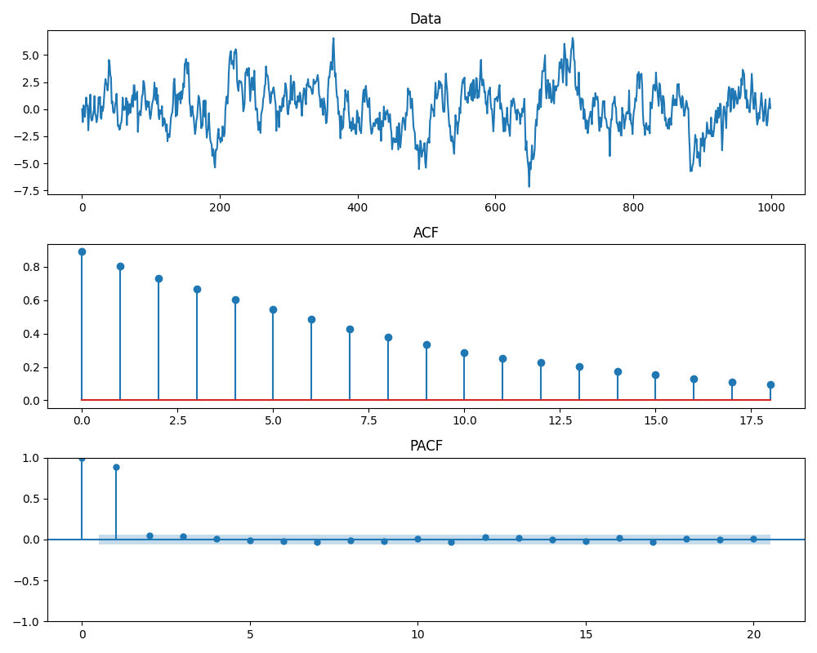
Lags: ACF and PACF Example with AR(1)

Slide 26
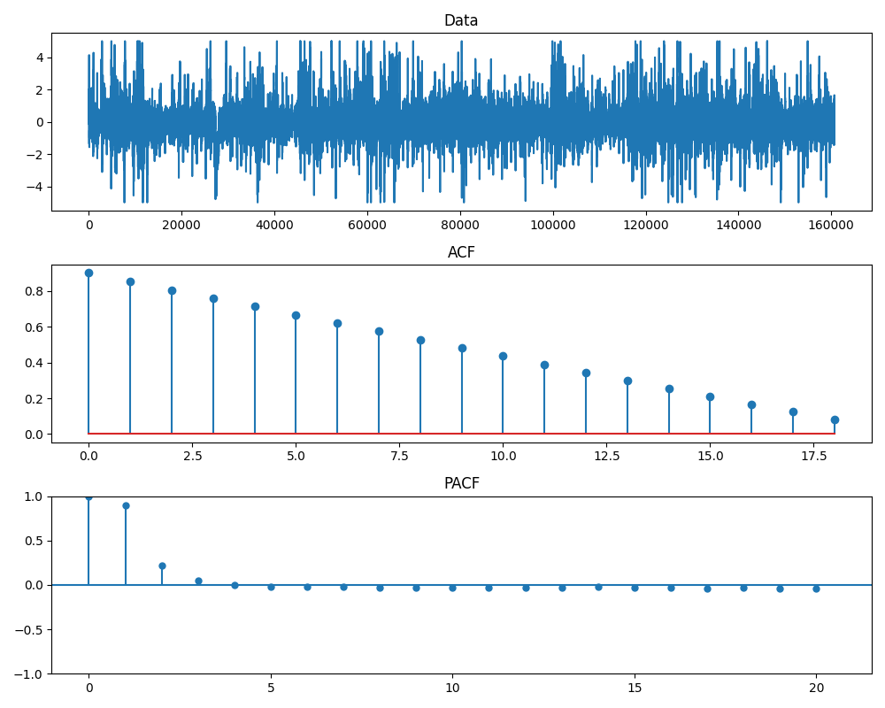
Lags: ACF and PACF Responder 6

Slide 27
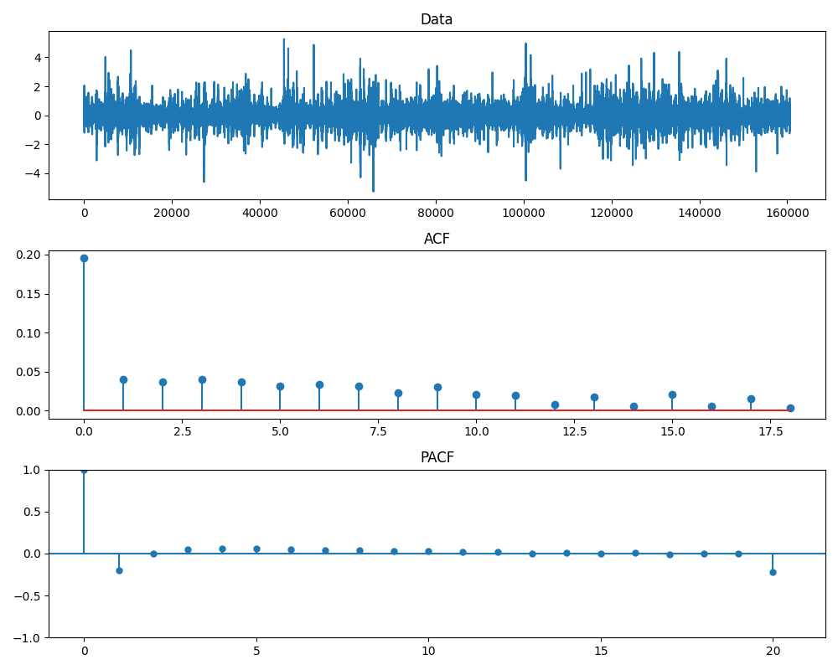
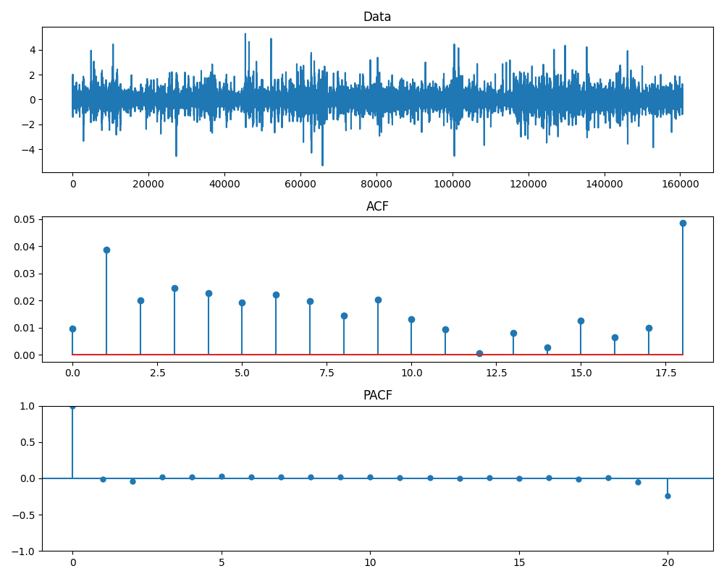
Checking Residuals After Removing Lags
Removing just 1st lag
Removing 1st and 2nd lag: maybe a bit of overkill, but possibly still ok

Slide 28
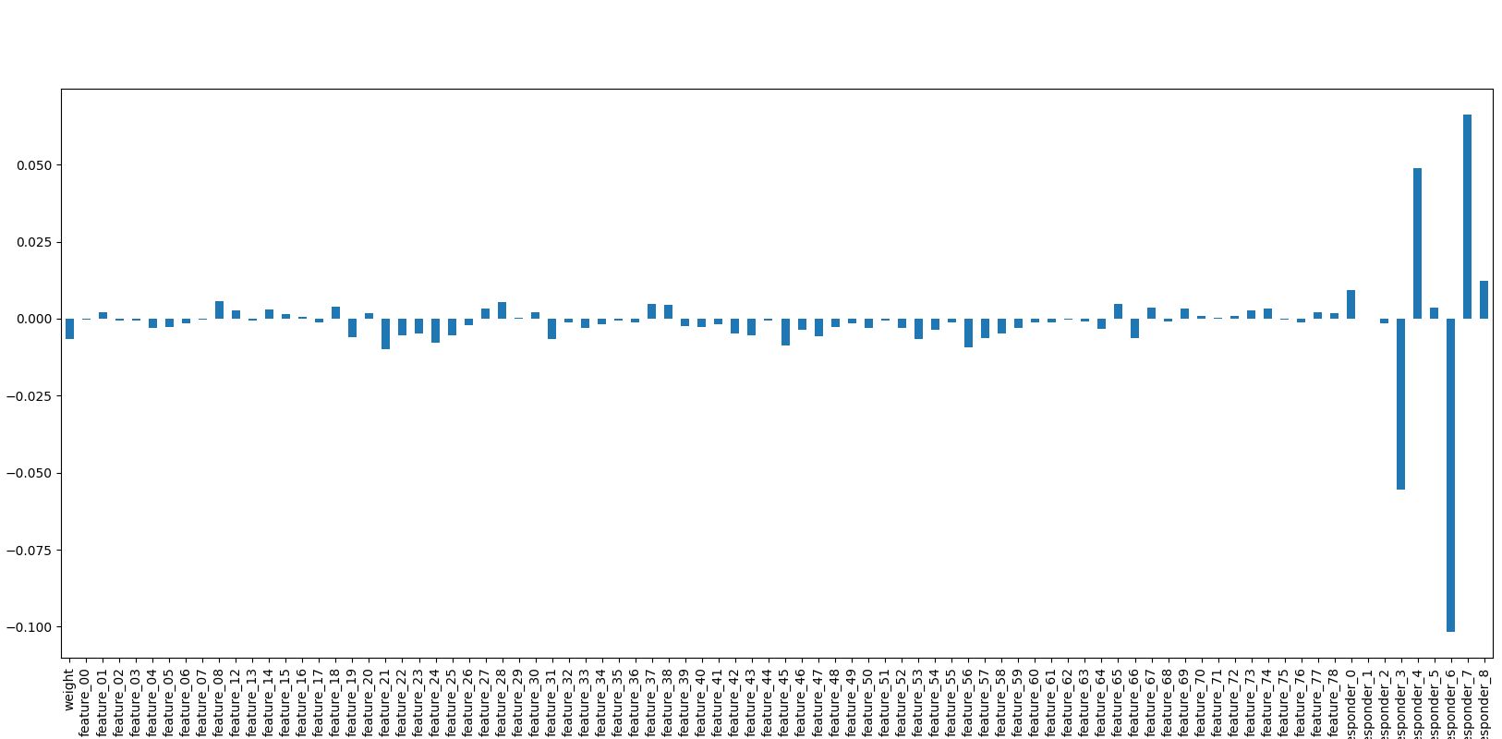
Correlation Analysis with Residuals
Good news: we got rid of most correlation with other responders
Bad news
The correlation with other features is VERY small
Things might improve if we have a longer horizon (this is just partition 9)
The highest correlation is with responder 6 itself
This suggests that either we should use yet another lag
OR, more likely, the correlation to other features is VERY nonlinear and/or time-varying

